Slide 1



(Distributed Denial of Service) DDoS Attack Detection System
Developed For : Datex Technologies Pvt. Ltd. www.datex.co.in
by Sachin Lohar www.sachinlohar.com
Dr. D.Y. Patil School of MCA, Lohegaon, Pune www.dypsomca.com

Slide 2

Letter of Appointment

Slide 3

Internship Completion Certificate

Slide 4
Introduction to DDoS Attack Detection System
DDOS (Distributed Denial of Service) attacks are a major threat to network security, overwhelming systems with malicious traffic to disrupt operations. This system will explore how machine learning techniques like SVM and Random Forest can be leveraged to effectively detect and mitigate DDOS attacks.

Slide 5

Challenges in Traditional DDOS Detection Methods
1
Signature-based Limitations
2
High False Positive Rates
3
Inability to Adapt
Traditional signature-based detection methods struggle to keep up with evolving attack patterns.
Legacy systems often generate high volumes of false alerts, leading to alert fatigue.
Static rule-based approaches fail to adapt to new types of DDOS threats.

Slide 6
Machine Learning Approach: SVM and Random Forest
Support Vector Machines (SVM)
Random Forest
Comparative Advantages
Random Forest is an ensemble learning method that combines multiple decision trees to improve detection accuracy and robustness.
SVM is a powerful supervised learning algorithm that can effectively classify DDOS attack traffic from normal network activity.
Both models offer unique strengths in terms of accuracy, scalability, and interpretability for DDOS detection.

Slide 7
Feature Engineering for DDOS Detection
Network Traffic Features
Resource Consumption
Analyzing packet headers, flow statistics, and connection patterns to identify anomalies.
Monitoring server CPU, memory, and bandwidth utilization to detect resource exhaustion attacks.
Behavioral Patterns
Domain Knowledge
Studying user and application behavior to distinguish legitimate requests from malicious ones.
Incorporating expert insight into feature selection to enhance the model's understanding of DDOS attacks.

Slide 8




Technology Used
Python
Scikit-learn
Pandas
NumPy
High-level programming language for data analysis and model development.
Machine learning library for implementation of SVM and Random Forest algorithms.
Data manipulation and analysis library for feature engineering and preprocessing.
Numerical computing library for efficient matrix operations and data structures.

Slide 9
SVM Model Development and Optimization
Data Preprocessing
1
Cleaning, scaling, and transforming the dataset for optimal model performance.
2
Hyperparameter Tuning
Systematically adjusting kernel, regularization, and other parameters to improve accuracy.
Model Evaluation
3
Assessing the SVM model's performance using metrics like precision, recall, and F1-score.

Slide 10

Random Forest Model Development and Optimization
1
Feature Importance
Analyzing the relative importance of different features in the Random Forest model.
2
Ensemble Optimization
Tuning the number of trees and other hyperparameters to enhance model performance.
3
Scalability Testing
Evaluating the model's ability to handle large-scale DDOS attack data.

Slide 11
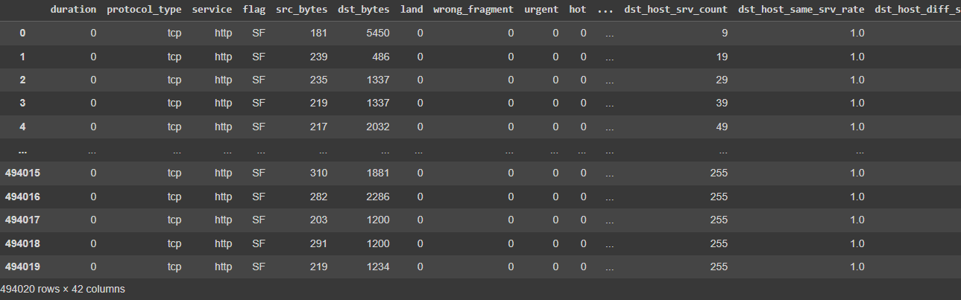
DataSet
Dataset Size = 494020 rows × 42 columns

Slide 12
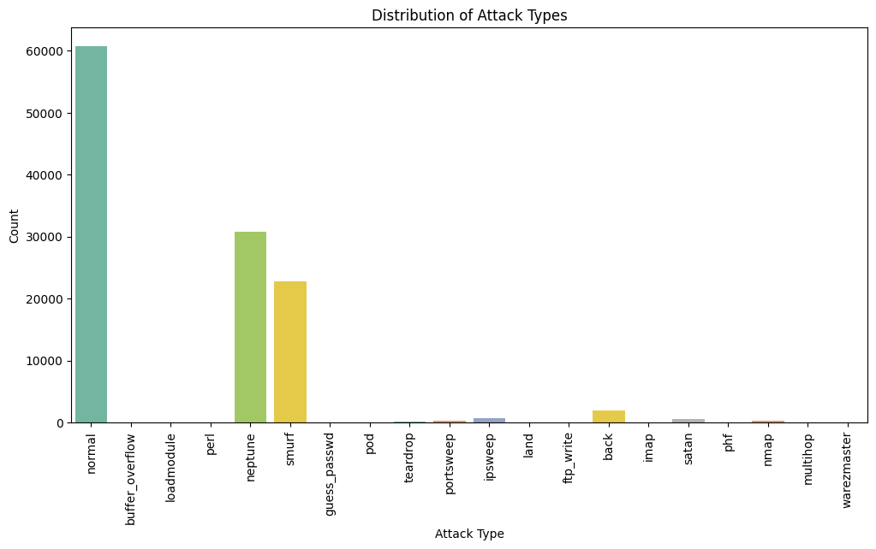
DataSet Analysis

Slide 13
Comparative Analysis of SVM and Random Forest
Metric
SVM
Random Forest
Accuracy
99%
99%
Training Time
Moderate
Fast
Interpretability
High
Medium
Scalability
Good
Excellent

Slide 14
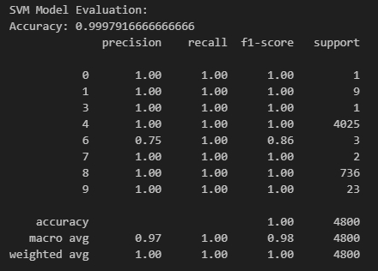
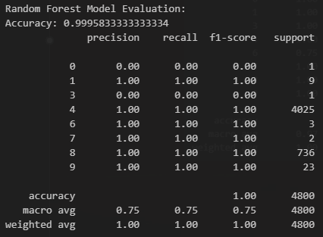
Model Evaluation

Slide 15
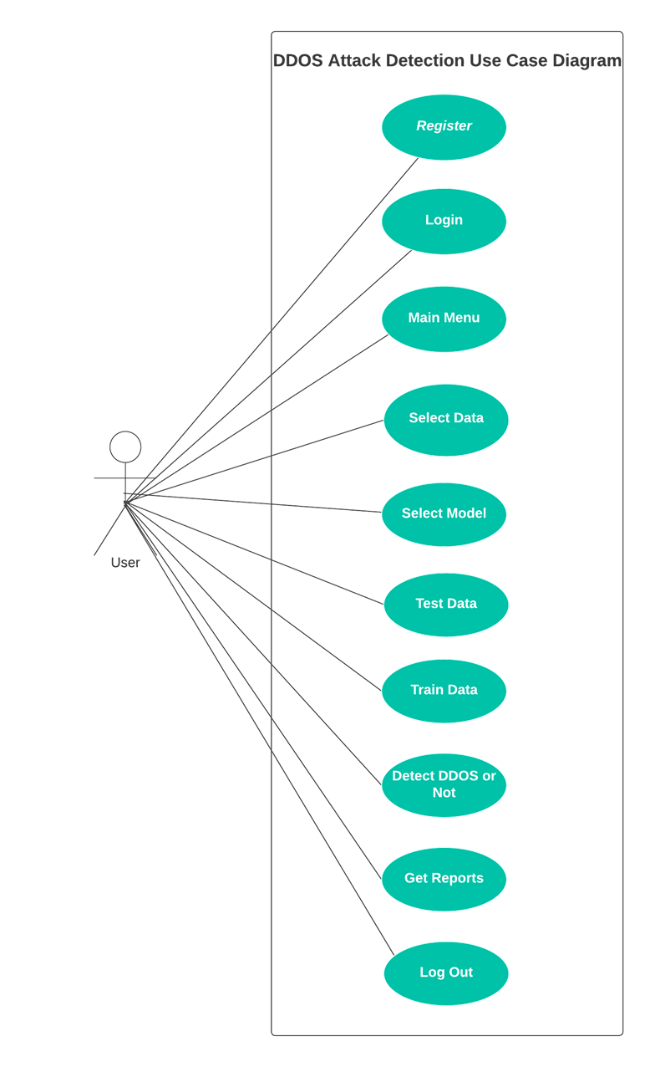
Use Case Diagram

Slide 16
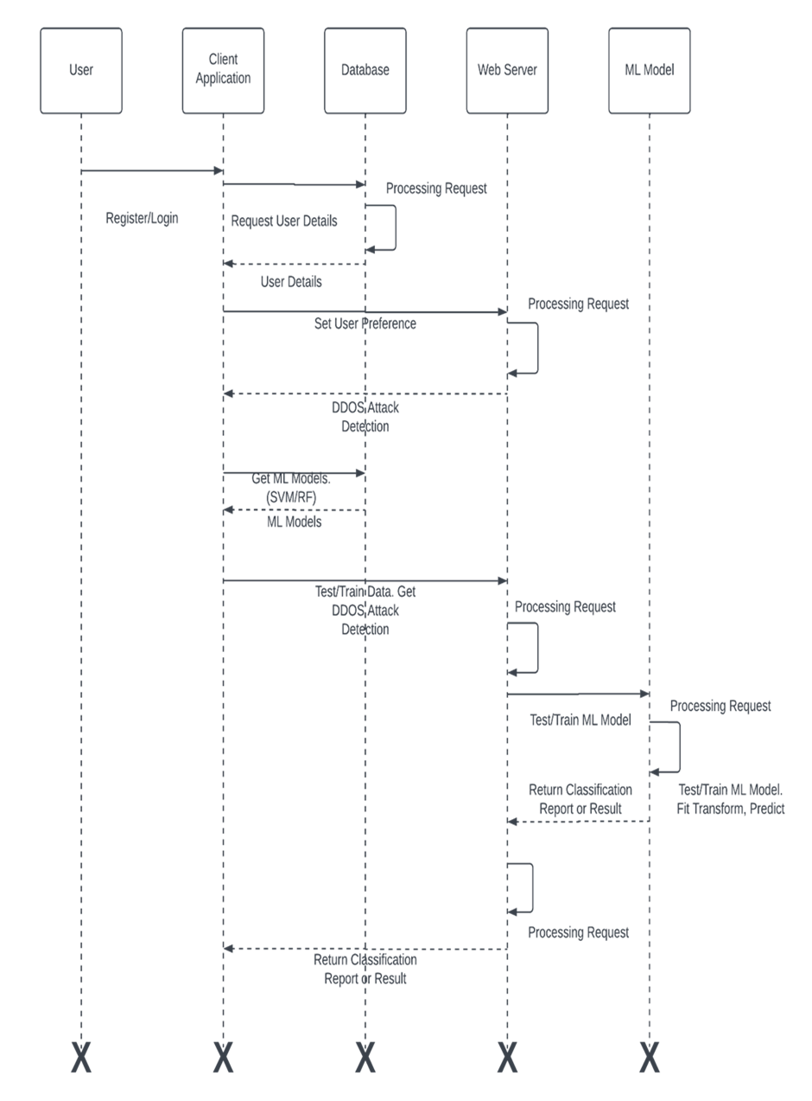
Sequence Diagram

Slide 17
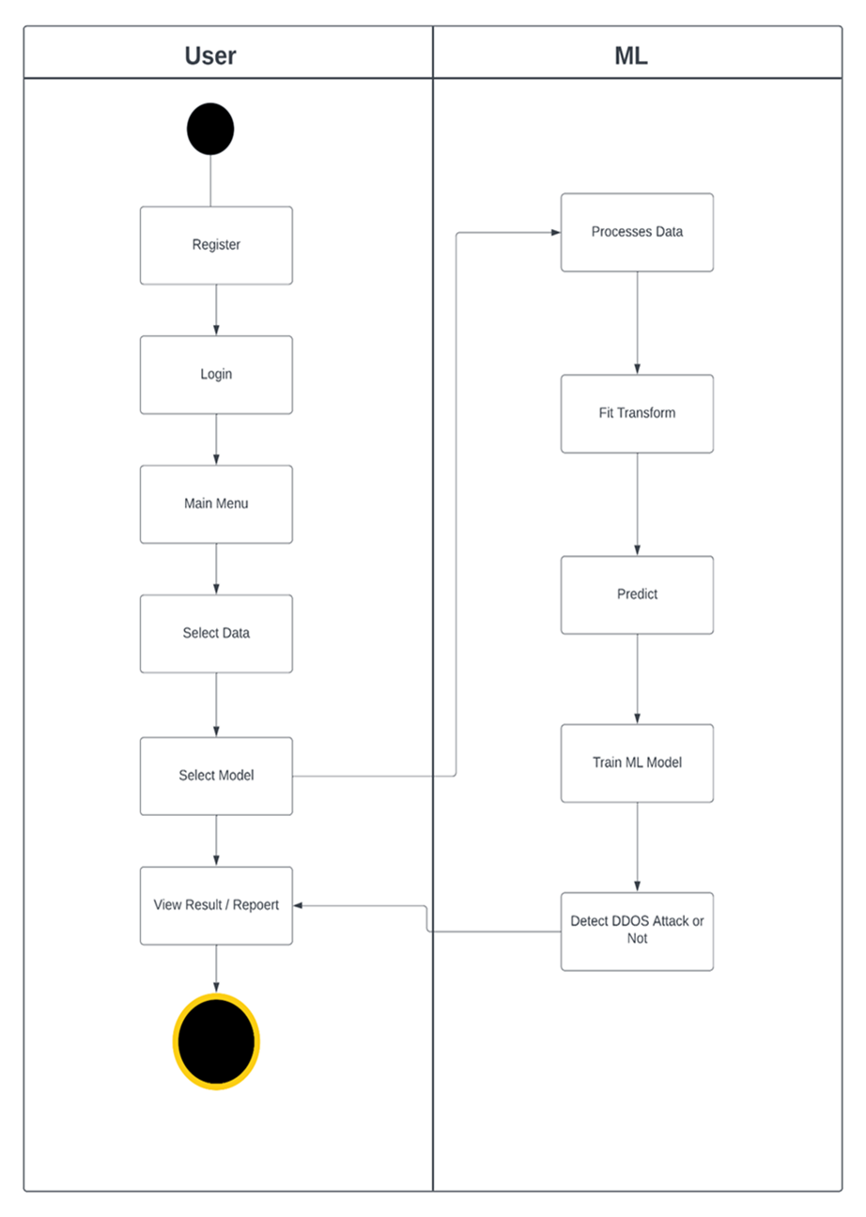
Activity Diagram

Slide 18
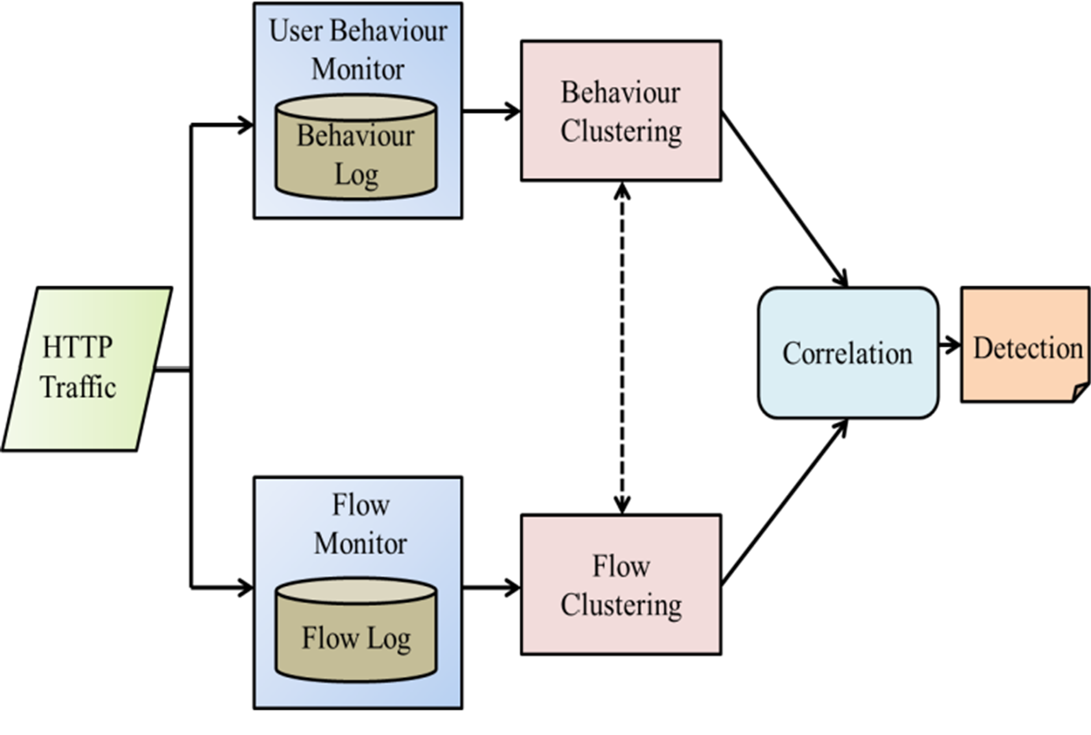
Deployment Diagram

Slide 19
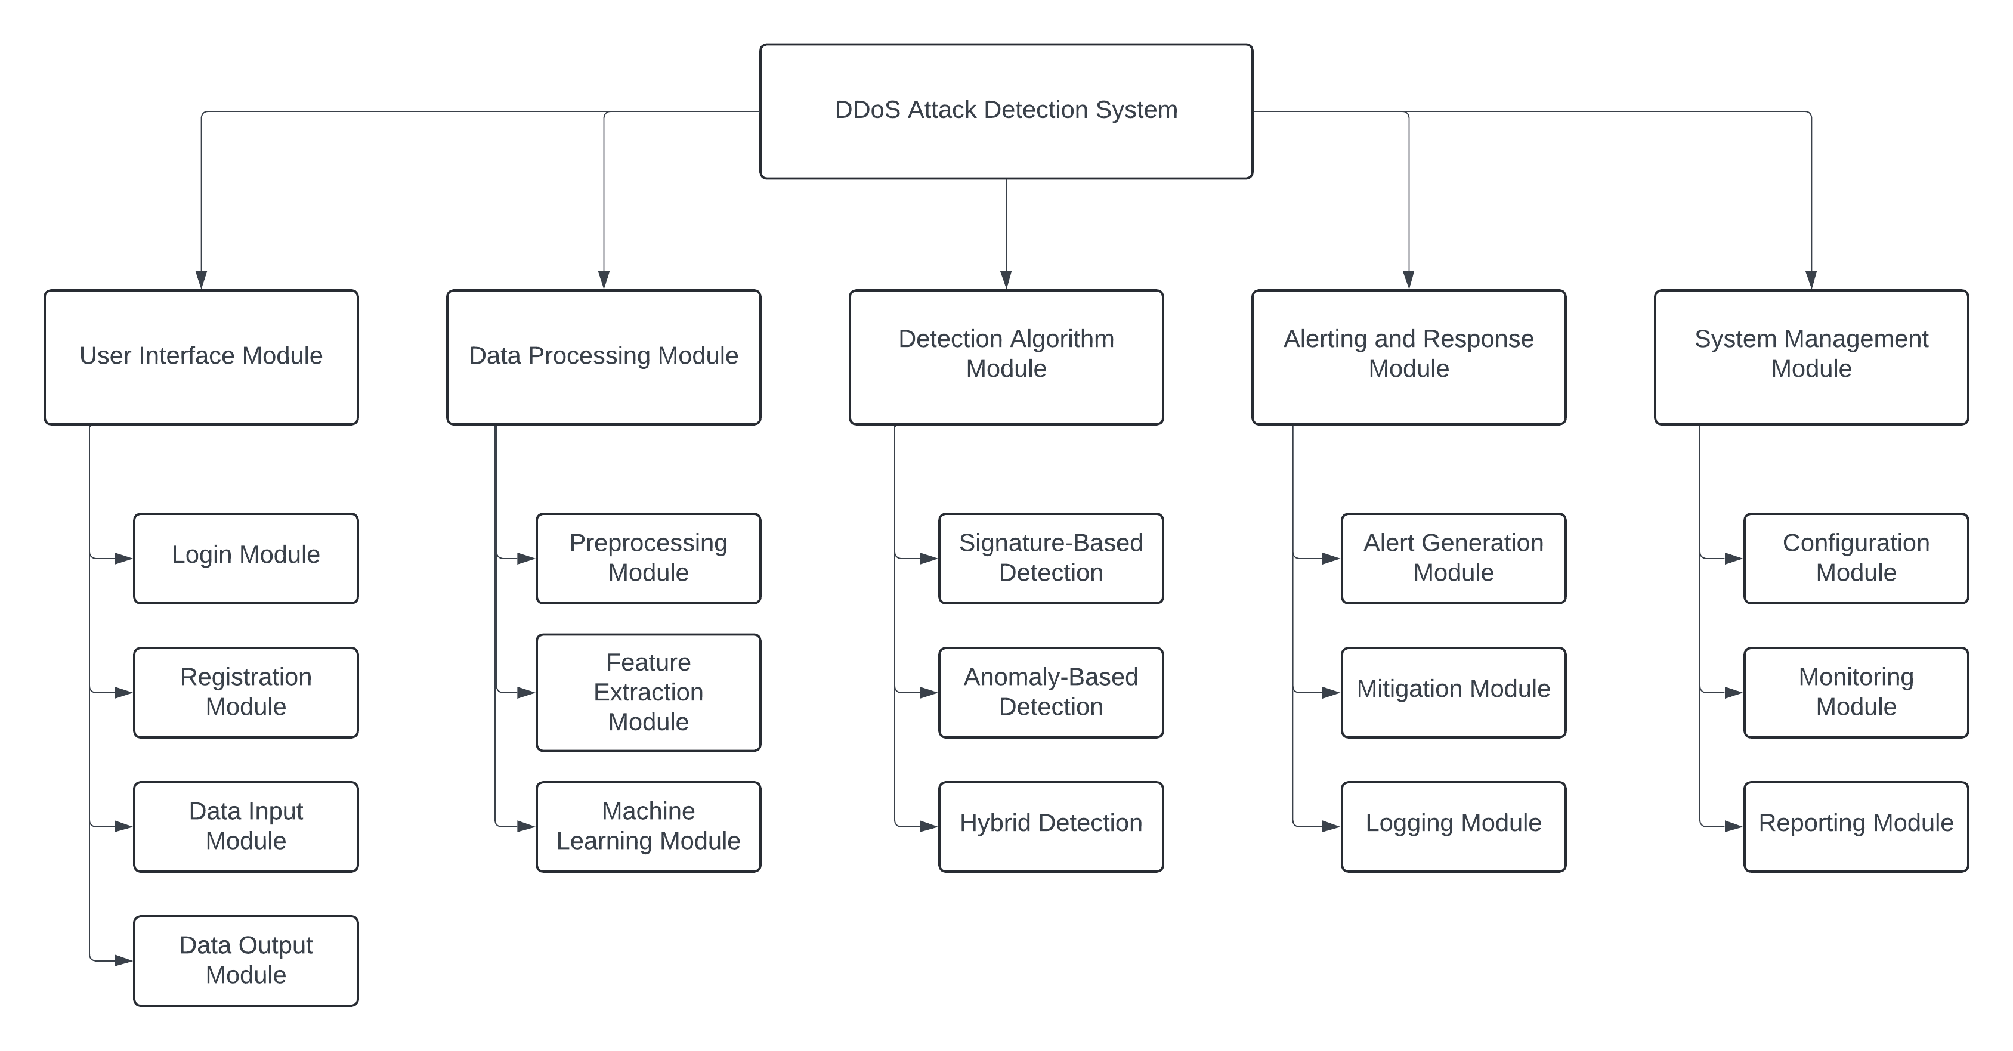
Module Hierarchy Diagram

Slide 20

Login

Slide 21

Dashboard

Slide 22

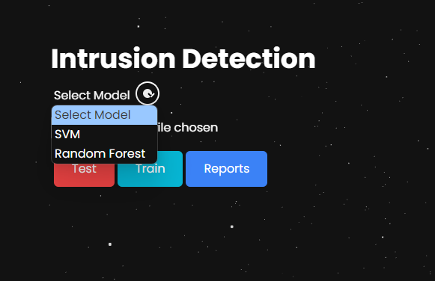
Intrusion Detection App
Select Model

Slide 23
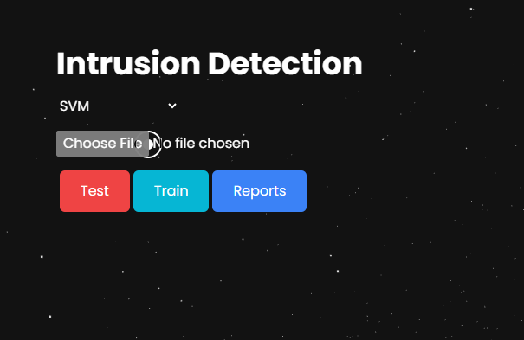
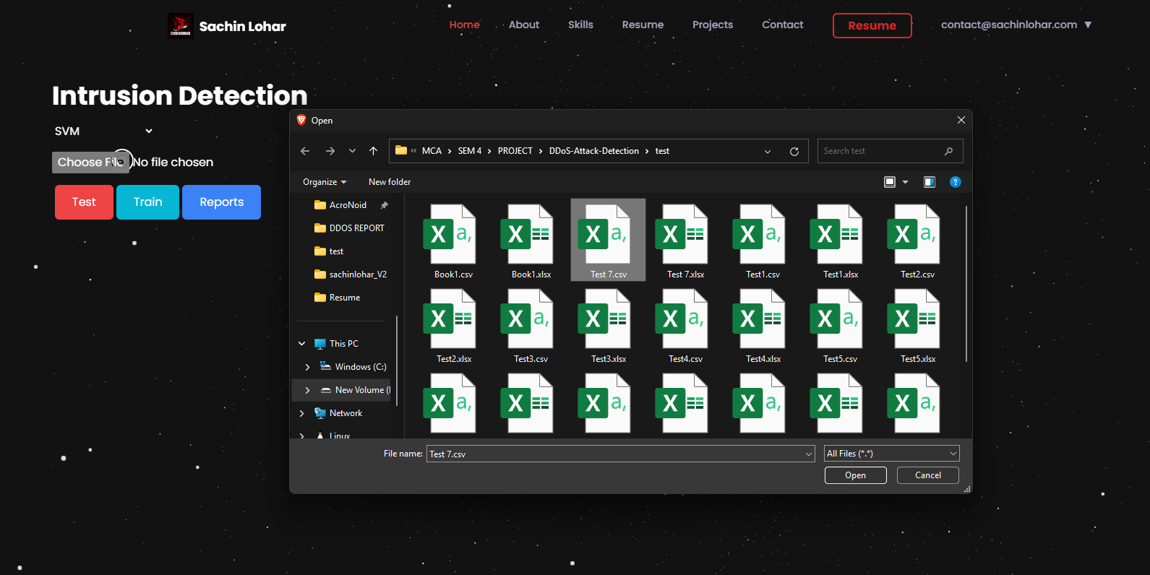
Choose File Data To Test/Train :

Slide 24
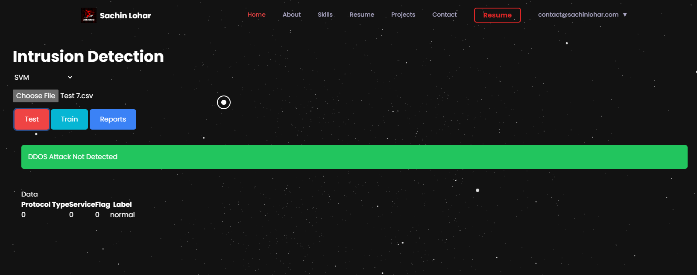
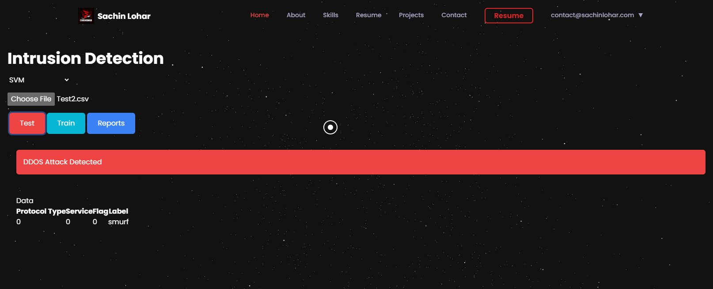
Test Data (DDoS or Not)

Slide 25
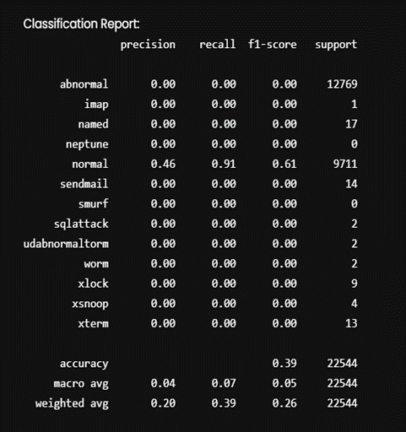
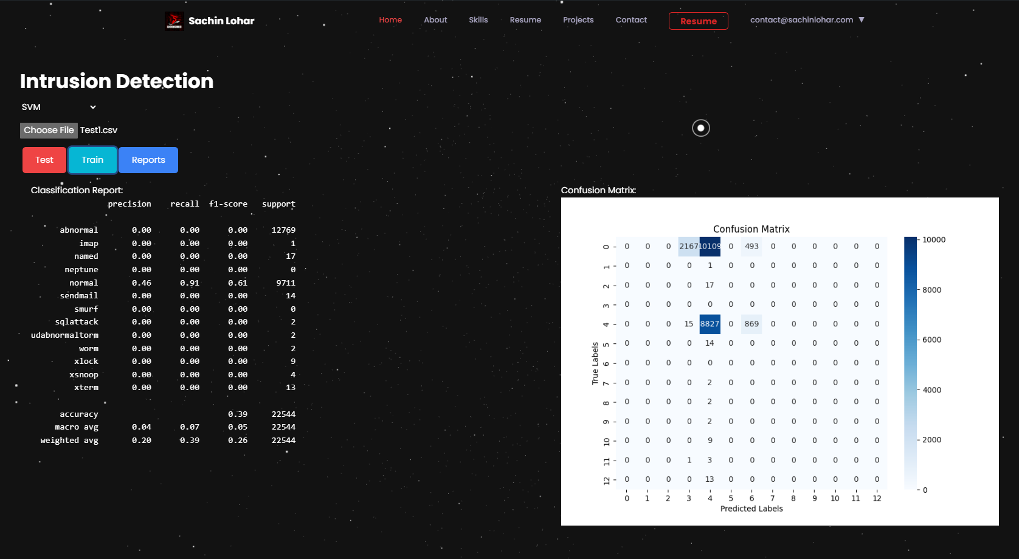
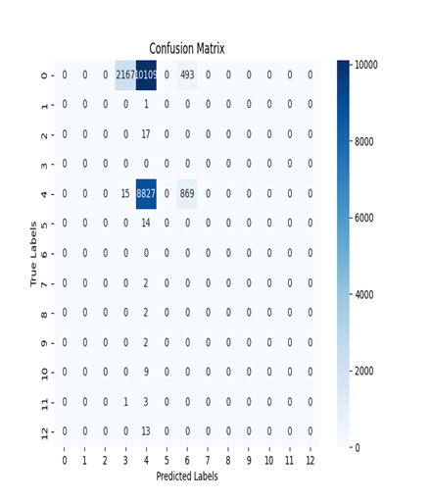
Train The Model with New Data

Slide 26
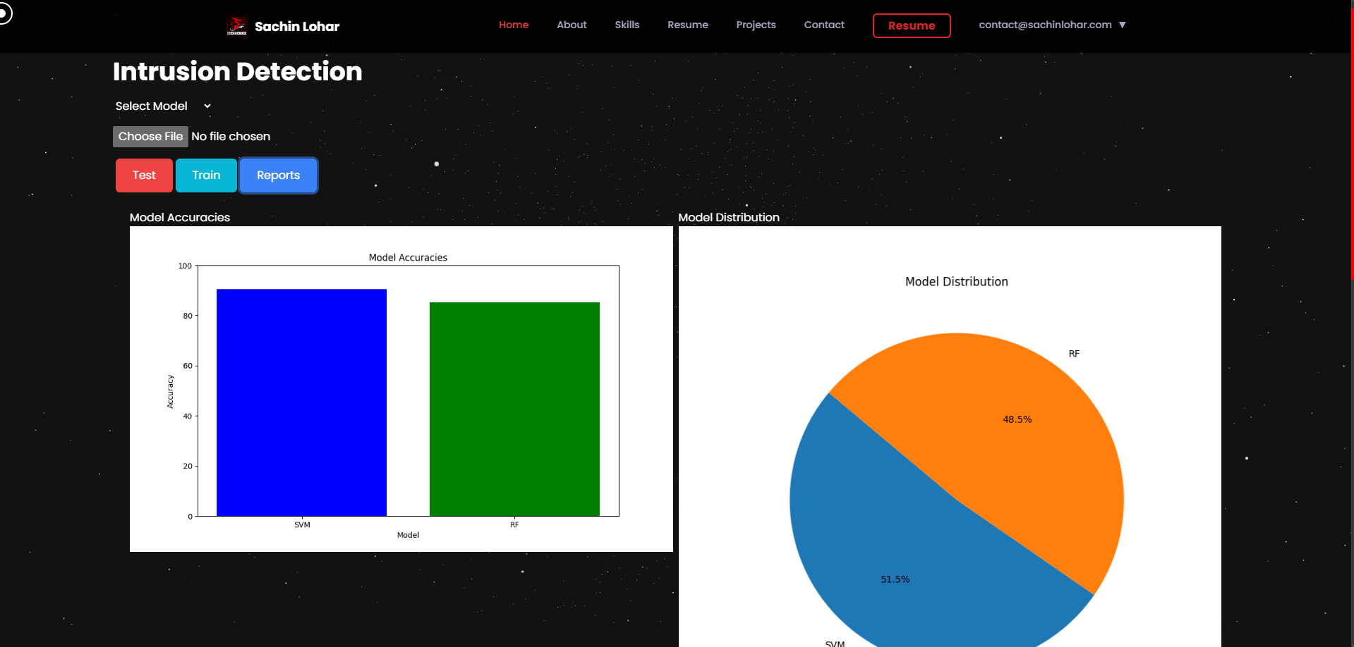
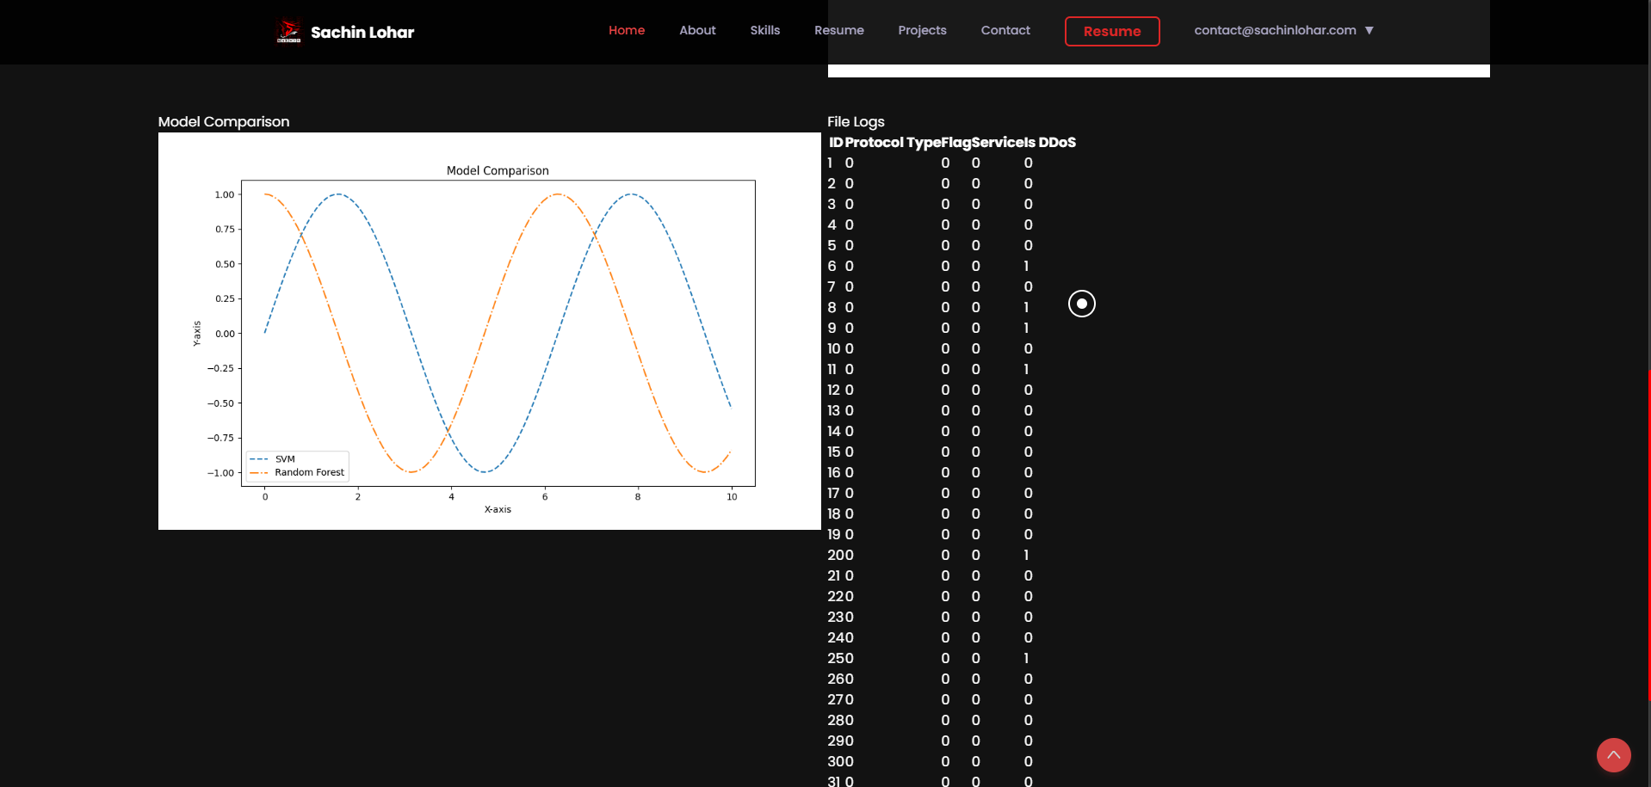
View Reports

Slide 27
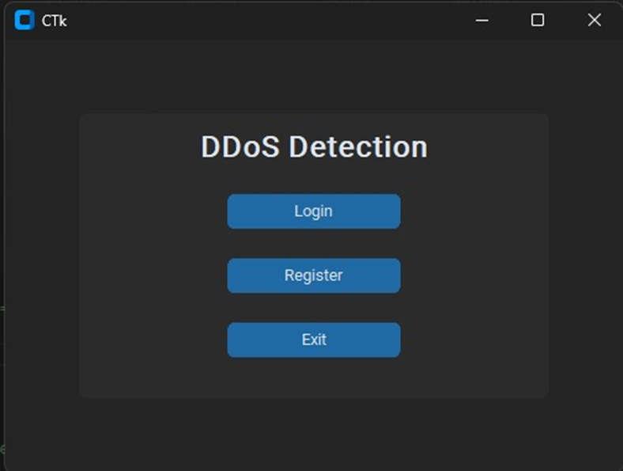
GUI App - Start Page

Slide 28
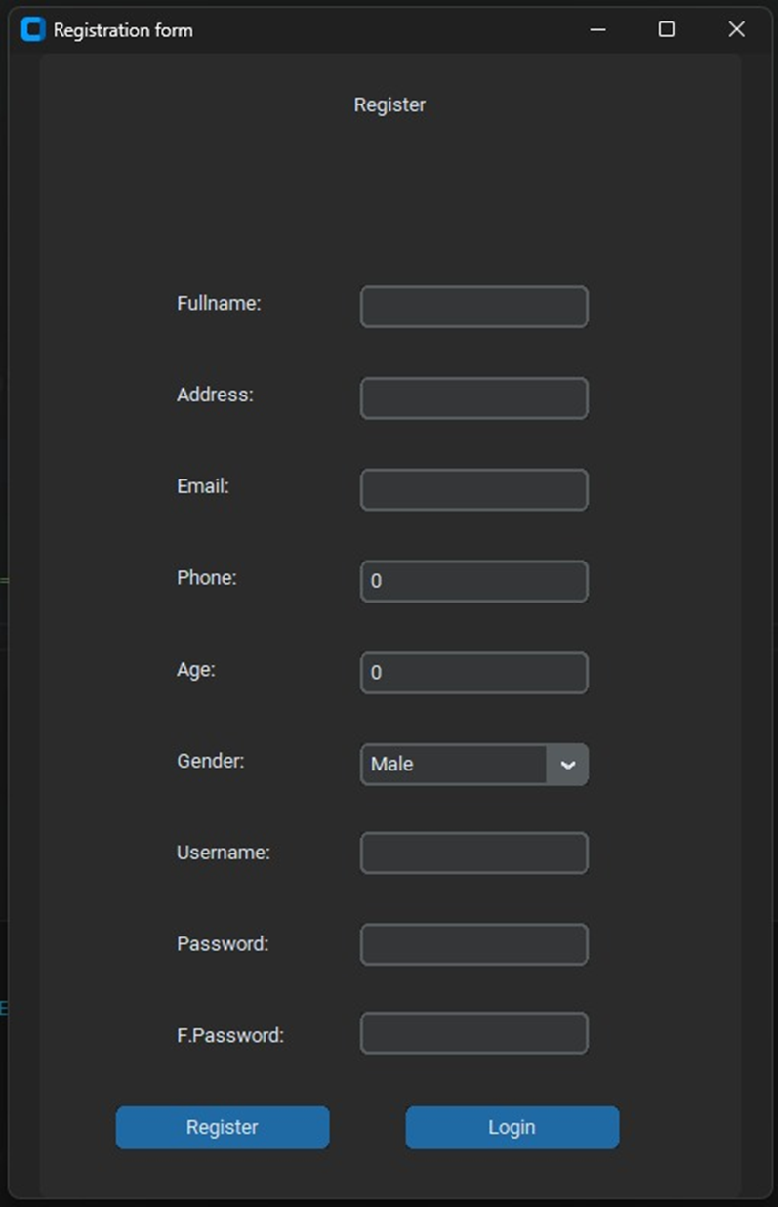
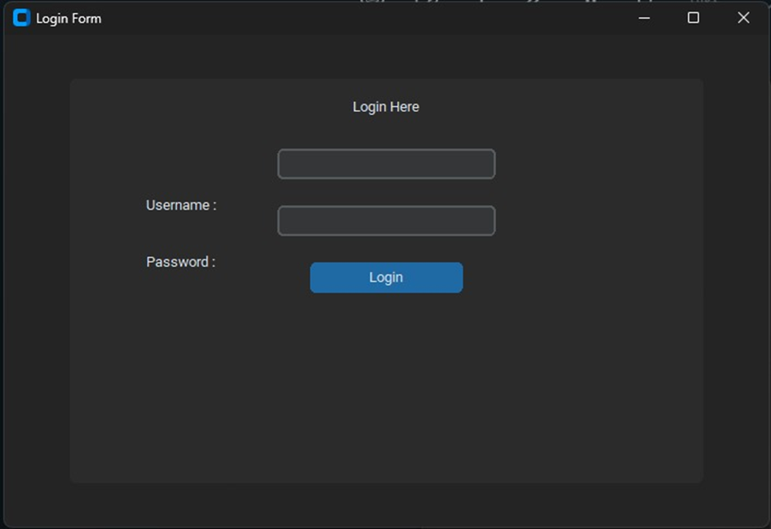
Register & Login Page

Slide 29

Main Page

Slide 30

DDoS Not Detected

Slide 31

DDoS Detected

Slide 32
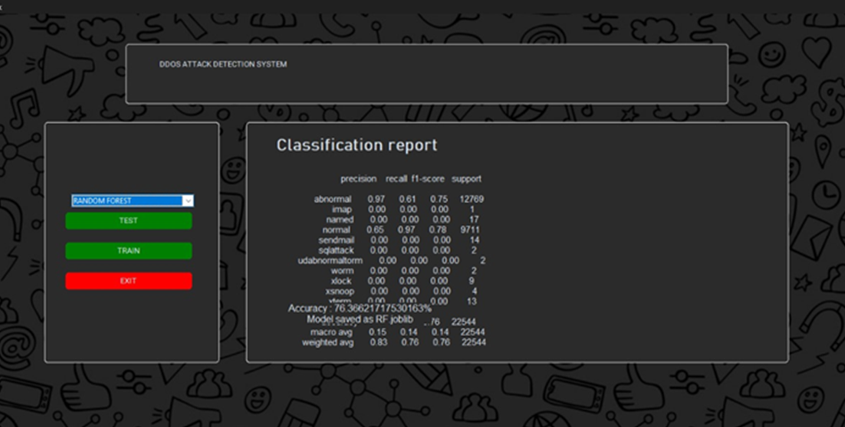
Train the Model using New Data

Slide 33




Conclusion and Future Considerations
Conclusion
Machine learning techniques like SVM and Random Forest have demonstrated their effectiveness in detecting and mitigating DDOS attacks, outperforming traditional methods.
Future Work
Exploring deep learning models, incorporating real-time traffic analysis, and developing adaptive defense systems to stay ahead of evolving DDOS threats.
Ongoing Research
Continuously refining feature engineering, model optimization, and integration with security orchestration platforms for a comprehensive DDOS defense solution.

